Slide 1
From Beats to Hits: Analysis and Prediction of Song Popularity Using Spotify’s Top 2000 Dataset
University of Kansas
Group 6
2025
Fall

Slide 2

The Team
Moh Absar Rahman
Rakib Hasan Rahad
Prianka Rani Saha
Nafiza Tabassoum
Team
Recap
Methodology
Future work
Master’s student
PhD student
PhD student
Master’s student

Slide 3
Thank you everyone
University of Kansas
Group 6
2025
Fall

Slide 4
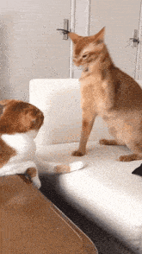
Team
Recap
Findings
Future work
Recap
Skip Recap
Sources:
https://tenor.com/view/cat-meme-gif-3361192861156476330

Slide 5
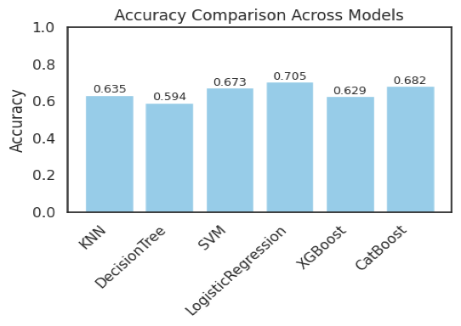
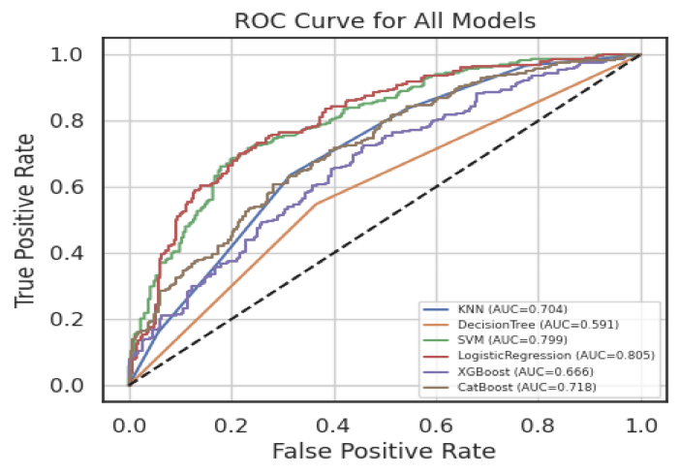
Team
Recap
Findings
Future work
Model and Feature Engineering Analysis
Feature Engineering:
Popularity Classification
Genre Simplification
Categorical Feature Encoding
Model Analysis:
KNN (K-Nearest Neighbors)
Decision Tree
SVM (Support Vector Machine)
Logistic Regression
XGBoost
CatBoost
Results
F1 Score
Recall
Precision
ROC Curve

Slide 6
Recap
Advanced Model Evaluation and Comparison
Team
Findings
Future work
Neural Network:
(MLPClassifier with hidden_layer_sizes=(128, 64, 32))
CatBoost with customized hyperparameters:
depth=8, learning_rate=0.05 (Default params: lr=0.03, depth=6)
LightGBM:
A gradient boosting framework that utilizes tree-based learning algorithms
TabNet:
A deep learning model designed for efficiently handling tabular data
StackedEnsemble:
A supervised ensemble ML algorithm that optimizes the combination of multiple prediction algorithms through a method called stacking
Source:
https://app.studyraid.com/en/read/14925/514329/learning-rate-and-iterations-optimization
https://lightgbm.readthedocs.io/en/latest/index.html
https://medium.com/@kdk199604/tabnet-a-deep-learning-breakthrough-for-tabular-data-bcd39c47a81c
https://docs.h2o.ai/h2o/latest-stable/h2o-docs/data-science/stacked-ensembles.html

Slide 7
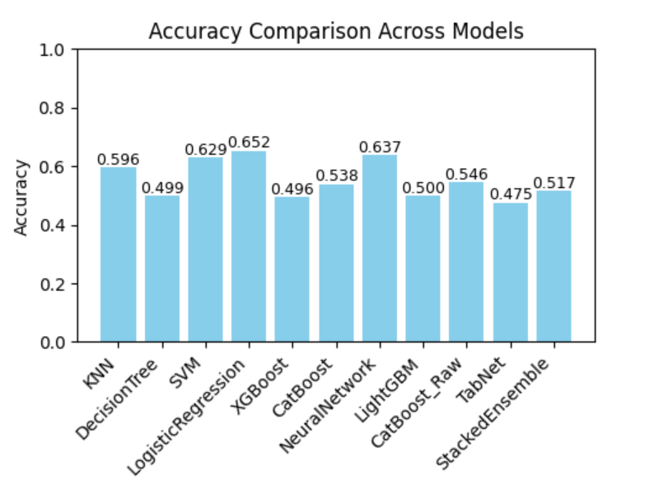
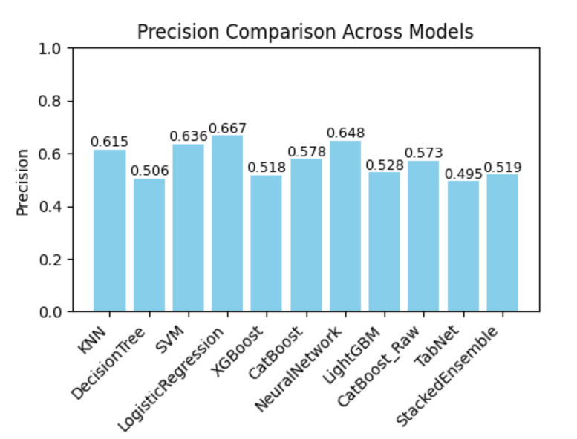
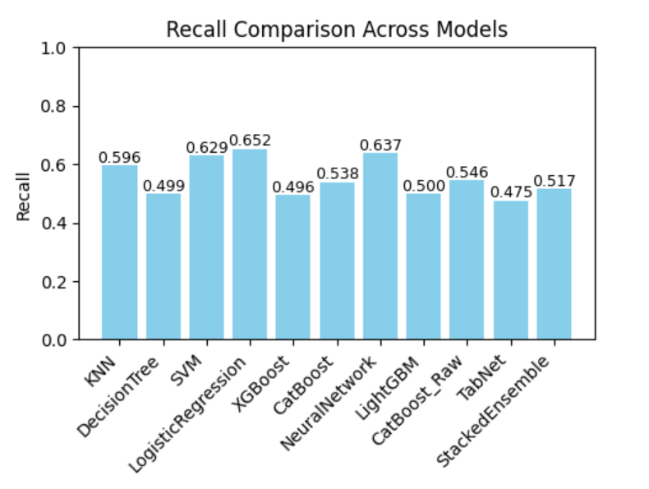
Recap
Results with One-hot encoding
Team
Findings
Future work

Slide 8
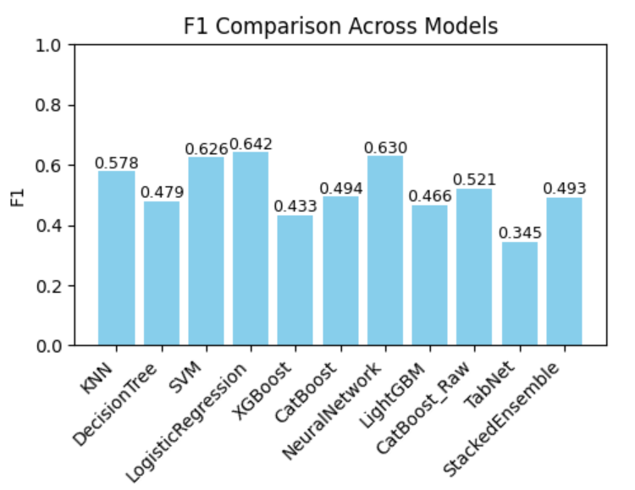
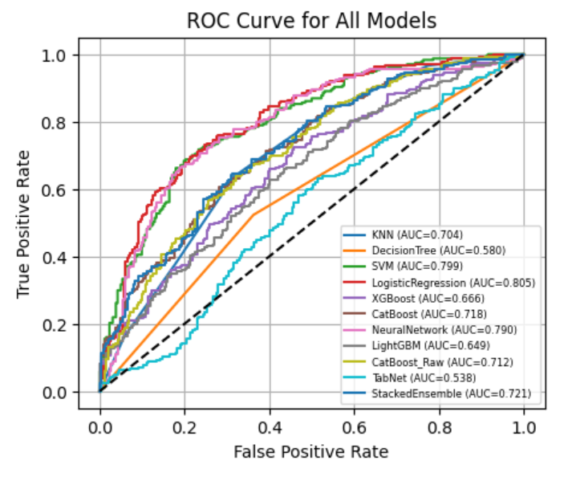
Recap
Results with One-hot encoding
Team
Findings
Future work

Slide 9
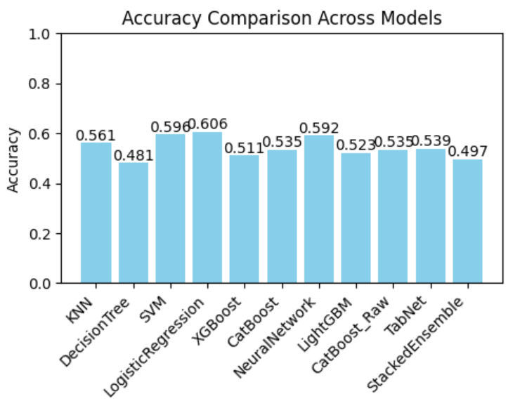
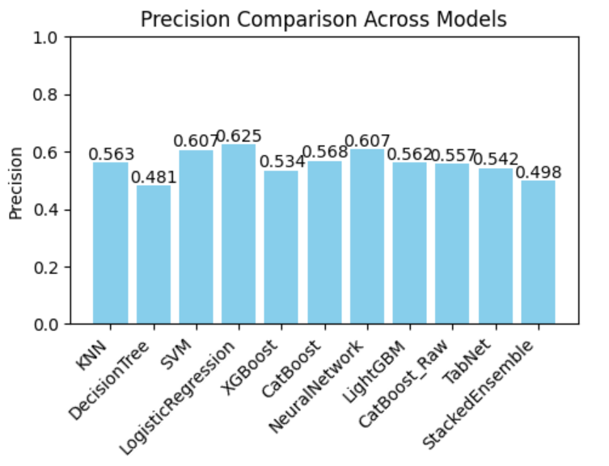
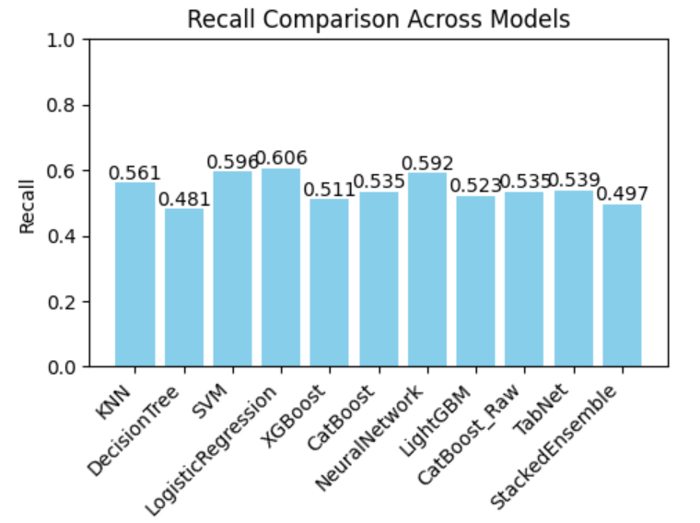
Recap
Results with Label encoding
Team
Findings
Future work

Slide 10
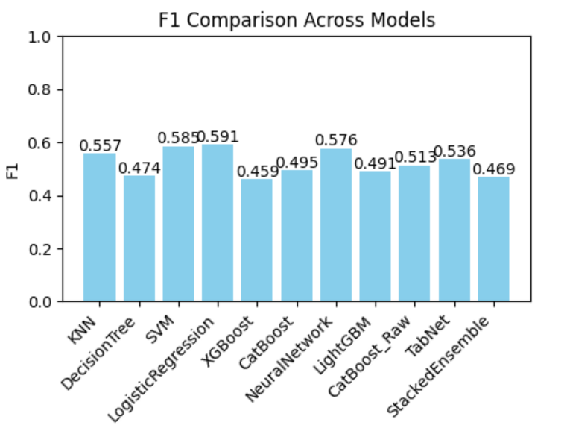
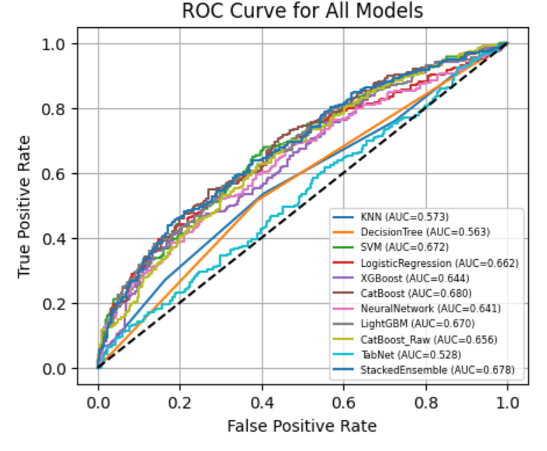
Recap
Results with Label encoding
Team
Findings
Future work

Slide 11
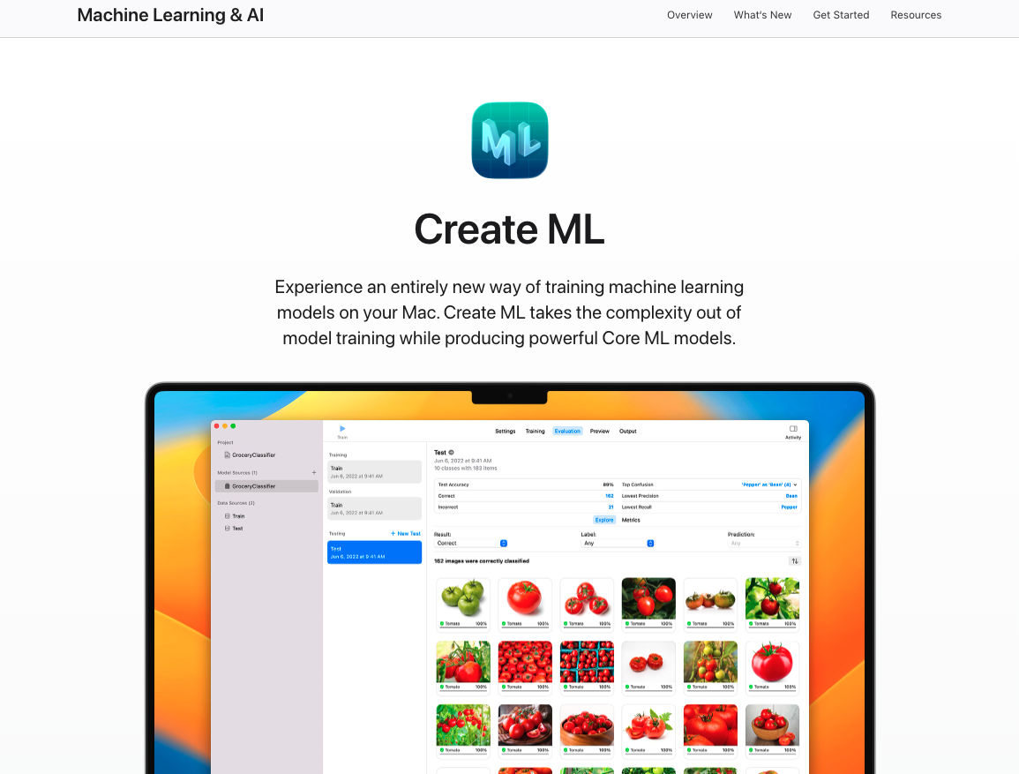
Recap
Create ML
Team
Findings
Future work
ML framework designed by Apple
Allows for easy model training without coding
Optimized for Apple Devices
Source:
https://developer.apple.com/machine-learning/create-ml/

Slide 12
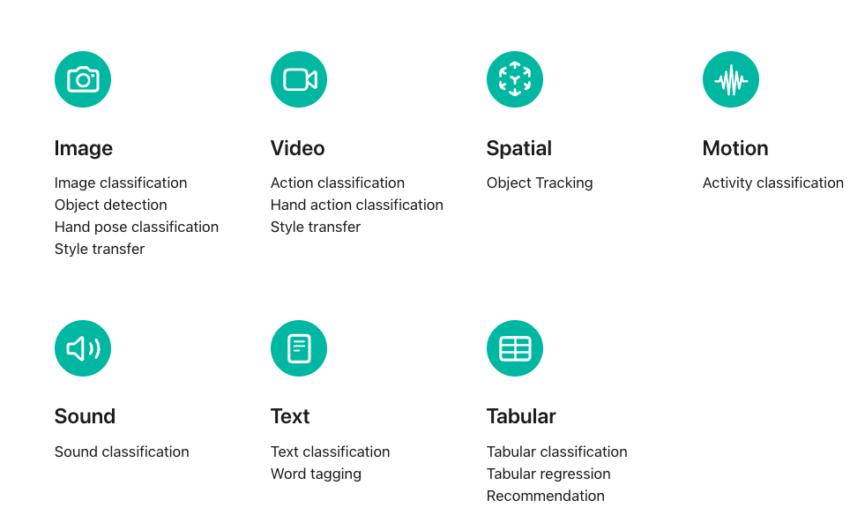
Recap
Create ML
Team
Findings
Future work
Source:
https://developer.apple.com/machine-learning/create-ml/

Slide 13
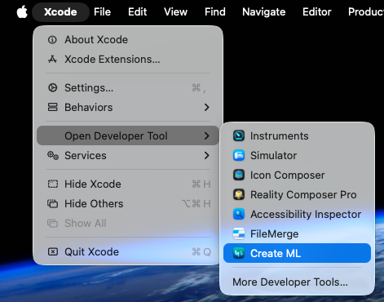
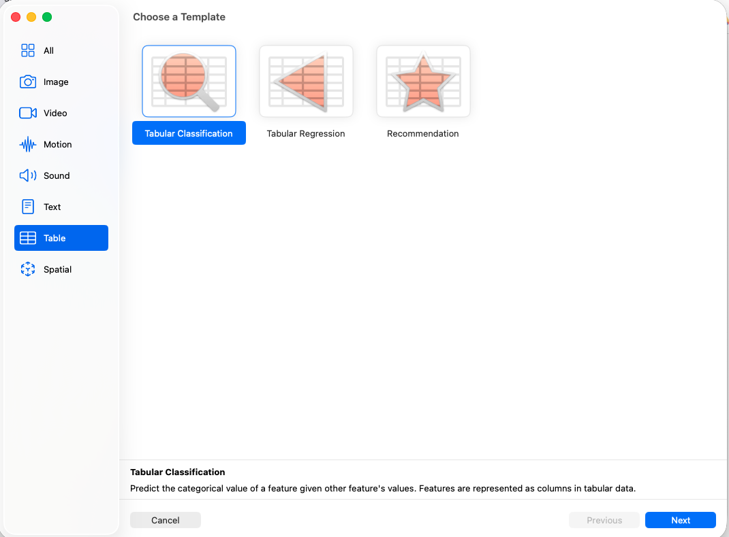
Recap
Create ML
Team
Findings
Future work

Slide 14
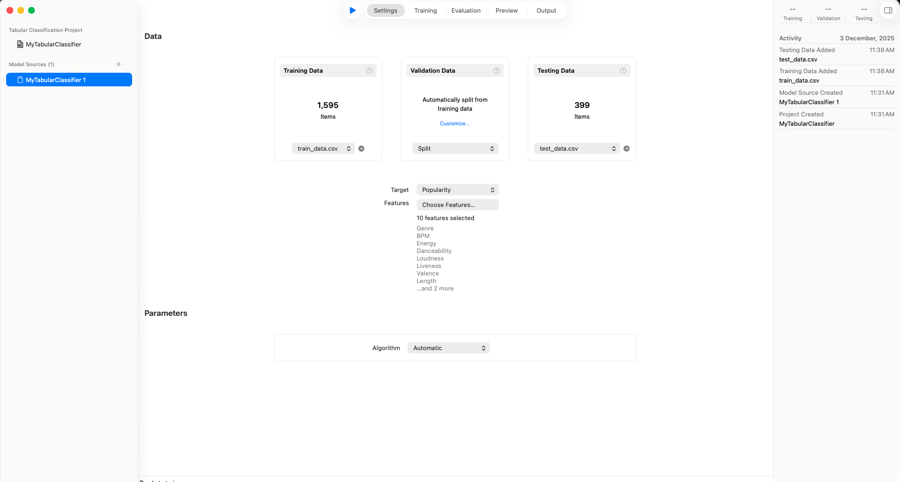
Recap
Create ML: Initial UI
Team
Findings
Future work

Slide 15
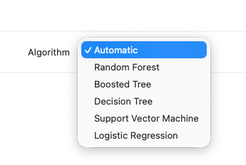
Recap
Algorithms in Create ML
Team
Findings
Future work

Slide 16
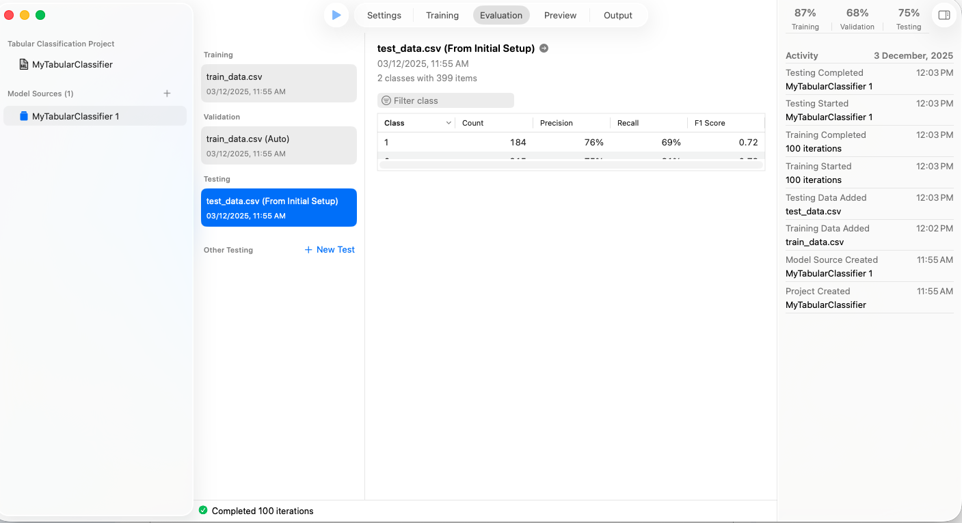
Recap
Results in Create ML:
(Logistic Regression)
Team
Findings
Future work

Slide 17
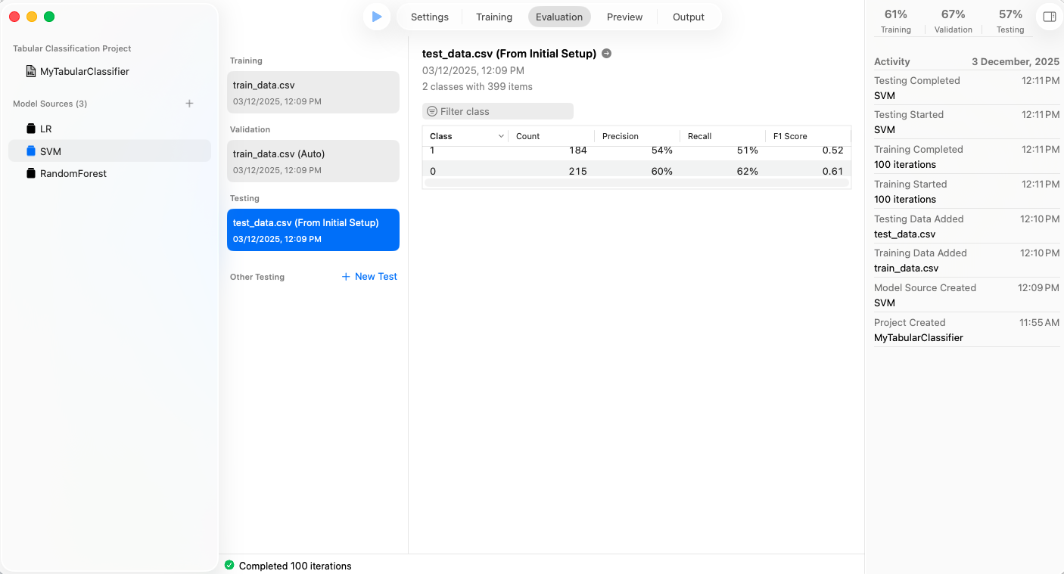
Recap
Results in Create ML:
(SVM)
Team
Findings
Future work

Slide 18

Recap
Results in Create ML:
(Random Forest)
Team
Findings
Future work

Slide 19
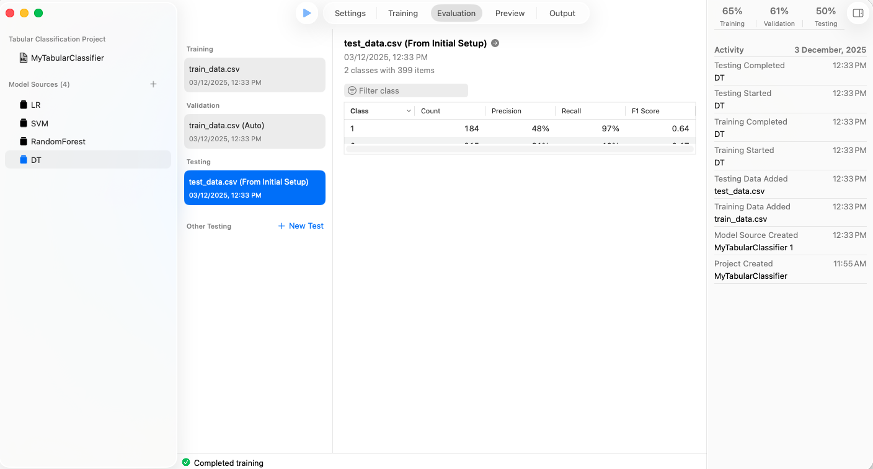
Recap
Results in Create ML:
(Decision Tree)
Team
Findings
Future work

Slide 20
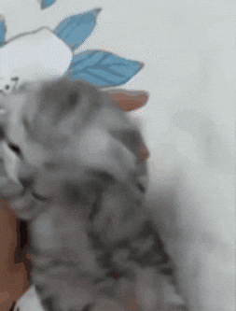
Recap
Drawbacks
Team
Findings
Future work
Preprocessing needs to be done before training
Limited flexibility
No option for splitting train and test dataset
Source:
https://giphy.com/gifs/cat-kitty-hold-fdiOoSR8omN5RO36Yo

Slide 21
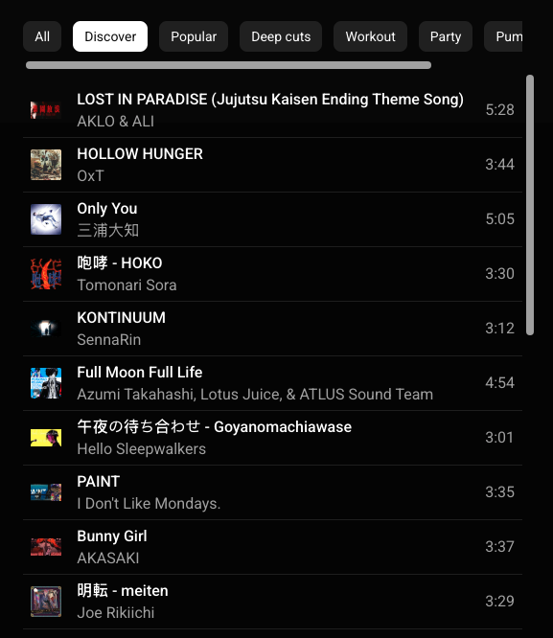
Recap
Recommendation System
Team
Findings
Future work

Slide 22
Recap
Similarity Learning Techniques
Team
Findings
Future work
Cosine Similarity:
Measures the cosine of the angle between two non-zero vectors
Maximum similarity (cosine => 1) for identical vectors
No similarity (cosine => 0) for orthogonal vectors
Limitations: Ignores magnitude -> only considers direction
Euclidean Distance:
Measures the straight-line distance between two points
Closer points = more similarity
Uses cases: Image recognition, low-dimensional spaces
Limitations: Becomes less intuitive in high-dimensional spaces -> equal importance to all features
Siamese Networks:
Neural network approach with two identical subnetworks
Ideal for signature verification, face verification
Limitations: Requires large datasets and computational power
Triplet Loss:
Involves an anchor, positive, and negative data point.
Main goal is to ensure anchor is closer to positive than negative
Ideal for differentiating very similar data points (e.g: similar images of different people)
Limitations: Requires careful selection of triplets -> computationally intensive
Source:
https://www.datacamp.com/blog/what-is-similarity-learning

Slide 23
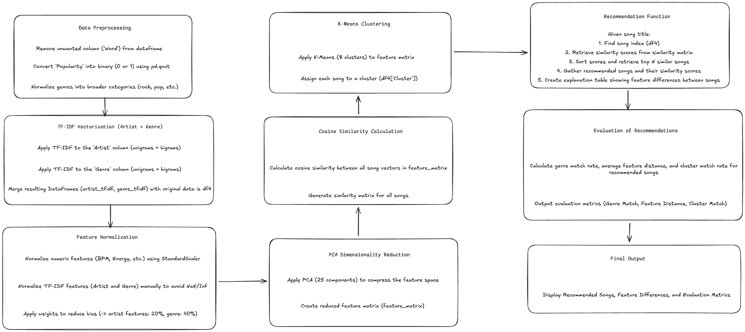
Recap
Architecture
Team
Findings
Future work

Slide 24
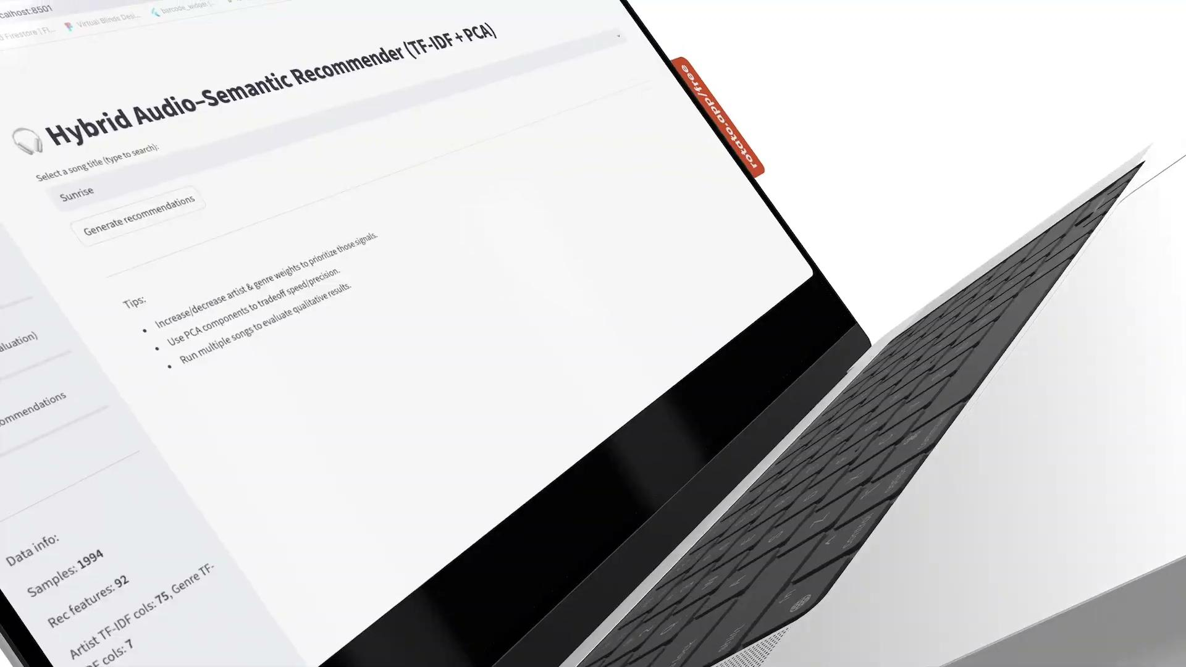
Recap
Demo
Team
Findings
Future work

Slide 25
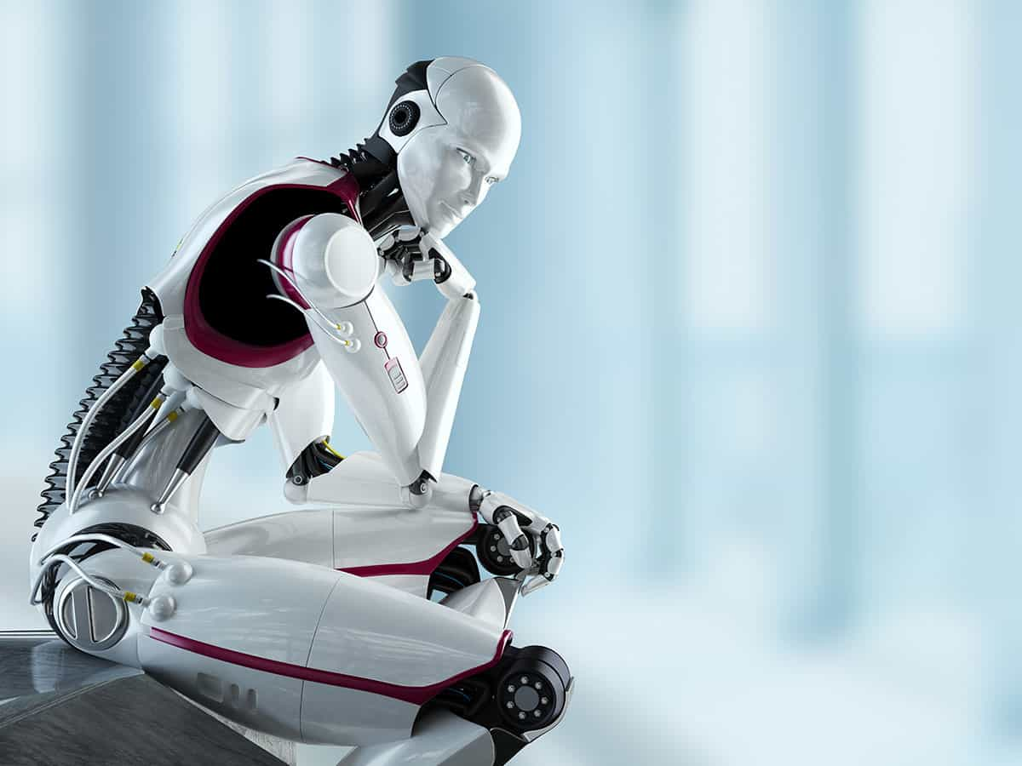
Future work
Future work
Team
Recap
Methodology
Limited Feature Representation: Actual recommendation systems are significantly more personalized than our current approach. They consider a much wider range of features:
User features: demographic (age, region), behavioral (plays, skips, likes, playlists), and contextual information (time, device)
Item features: audio embeddings (tempo, pitch), detailed metadata (artist, genre), and collaborative embeddings
Interaction features: user–song pair embeddings, time-decay patterns, and recency effects

Slide 26
Future work
Future work
Team
Recap
Methodology
2) Integration of Lyrics Data: We identified another dataset
(“Spotify Million Song Dataset”) that includes lyrics, which can be merged with our current dataset to improve recommendation accuracy, clustering, and semantic understanding of songs. (https://www.kaggle.com/datasets/notshrirang/spotify-million-song-dataset )

Slide 27
Future work
Future work
Team
Recap
Methodology
3) Scalability & Real-Time Deployment : The current system
is designed for offline use; it is computationally expensive
as the dataset size grows, and future work should include
optimising the pipeline for real-time recommendation and
larger-scale datasets. (Spotify, Apple Music, YouTube),
recommendation pipelines rely on distributed systems,
pre-trained embeddings, ANN search, and
deep-learning-based retrieval models, which allow
real-time recommendations for millions of songs and users

Slide 28
Future work
Future work
Team
Recap
Methodology
4) Audio data:
Extract audio features like:
Loudness
Tempo
Pitch
Energy
Advanced Techniques:
Mel-Frequency Cepstral Coefficients (MFCCs)
Mel Spectrogram
Transformers

Slide 29
Thank you!
University of Kansas

